Slide 1
Ch#5: Deep learning for computer vision
Dr. Noman Islam

Slide 2
Introduction
Convolutional neural networks, also known as Convnets, is a type of deep-learning model almost universally used in computer vision applications
Image classification is the task of classifying a whole image as a single label
For example, an image classification task could label an image as a dog or a cat, given an image is either a dog or a cat

Slide 3
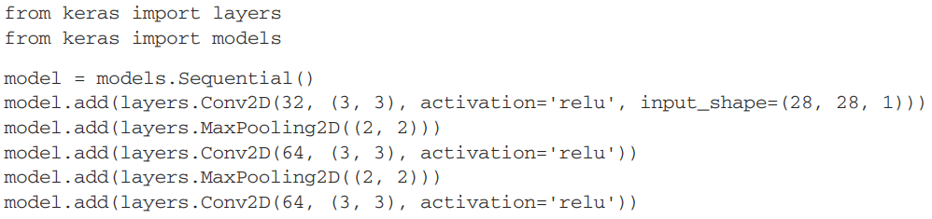

Creating a ConvNet in Keras

Slide 4
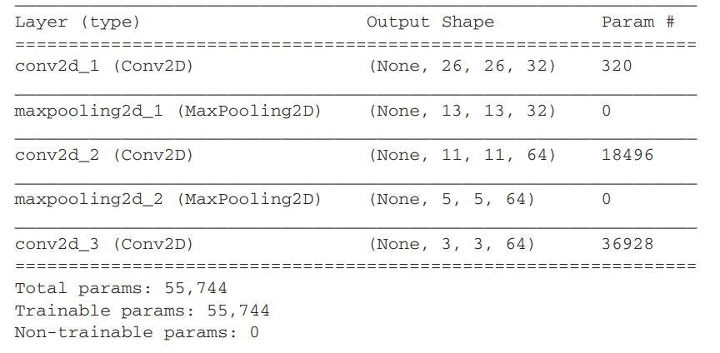
Summary of the model

Slide 5
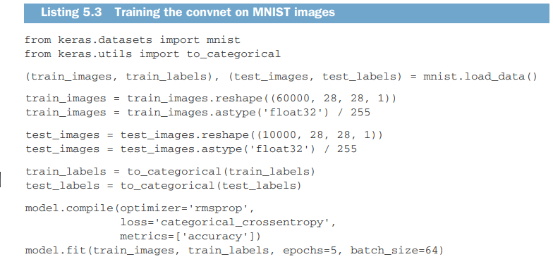

Slide 6
Convolution Operation
The fundamental difference between a densely connected layer and a convolution layer is this:
Dense layers learn global patterns in their input feature space (for example, for a MNIST digit, patterns involving all pixels),
whereas convolution layers learn local patterns in the case of images, patterns found in small 2D windows of the inputs.

Slide 7
The patterns are translation invariant
After learning a certain pattern in the lower-right corner of a picture, a convnet can recognize it anywhere: for example, in the upper-left corner.
A densely connected network would have to learn the pattern anew if it appeared at a new location.
This makes convnets data efficient when processing images (because the visual world is fundamentally translation invariant): they need fewer training samples to learn representations that have generalization power.

Slide 8
Learn spatial hierarchies of patterns
A first convolution layer will learn small local patterns such as edges, a second convolution layer will learn larger patterns made of the features of the first layers, and so on.
This allows convnets to efficiently learn increasingly complex and abstract visual concepts (because the visual world is fundamentally spatially hierarchical).

Slide 9
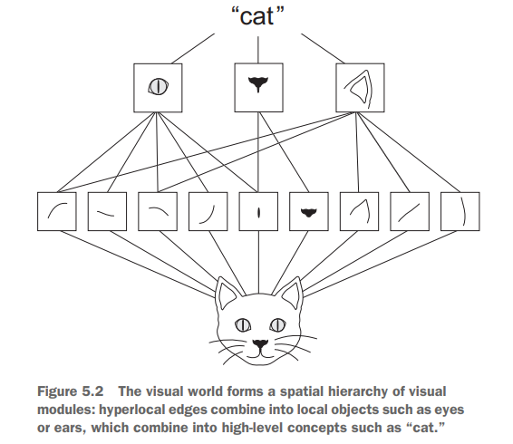

Slide 10
Feature maps
Convolutions operate over 3D tensors, called feature maps, with two spatial axes (height and width) as well as a depth axis (also called the channels axis).
The convolution operation extracts patches from its input feature map and applies the same transformation to all of these patches, producing an output feature map.
This output feature map is still a 3D tensor: it has a width and a height.
Its depth can be arbitrary, because the output depth is a parameter of the layer

Slide 11
Filters encode specific aspects of the input data: at a high level, a single filter could encode the concept “presence of a face in the input,” for instance.
In the MNIST example, the first convolution layer takes a feature map of size (28, 28, 1) and outputs a feature map of size (26, 26, 32): it computes 32 filters over its input.
Each of these 32 output channels contains a 26 × 26 grid of values, which is a response map of the filter over the input, indicating the response of that filter pattern at different locations in the input

Slide 12
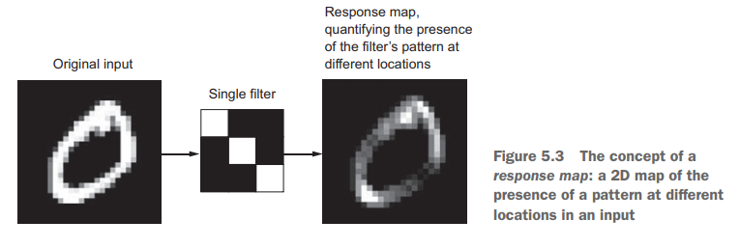

Slide 13
Convolutions are defined by two key parameters:
Size of the patches extracted from the inputs—These are typically 3 × 3 or 5 × 5. In the example, they were 3 × 3, which is a common choice.
Depth of the output feature map—The number of filters computed by the convolution. The example started with a depth of 32 and ended with a depth of 64.

Slide 14
Convolution
A convolution works by sliding these windows of size 3 × 3 or 5 × 5 over the 3D input feature map, stopping at every possible location, and extracting the 3D patch of surrounding features (shape (window_height, window_width, input_depth)).
Each such 3D patch is then transformed (via a tensor product with the same learned weight matrix, called the convolution kernel) into a 1D vector of shape (output_depth,).

Slide 16
All of these vectors are then spatially reassembled into a 3D output map of shape (height, width, output_depth).
Every spatial location in the output feature map corresponds to the same location in the input feature map (for example, the lower-right corner of the output contains information about the lower-right corner of the input).

Slide 17
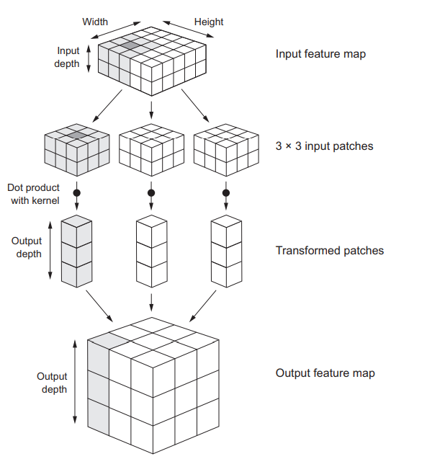

Slide 18
Note that the output width and height may differ from the input width and height. They may differ for two reasons:
Border effects, which can be countered by padding the input feature map
The use of strides

Slide 19
Padding
In Conv2D layers, padding is configurable via the padding argument, which takes two values: "valid", which means no padding (only valid window locations will be used); and "same", which means “pad in such a way as to have an output with the same width and height as the input.”
The padding argument defaults to "valid".

Slide 20
Max pooling
Max pooling consists of extracting windows from the input feature maps and outputting the max value of each channel.
It’s conceptually similar to convolution, except that instead of transforming local patches via a learned linear transformation (the convolution kernel), they’re transformed via a hardcoded max tensor operation.

Slide 21
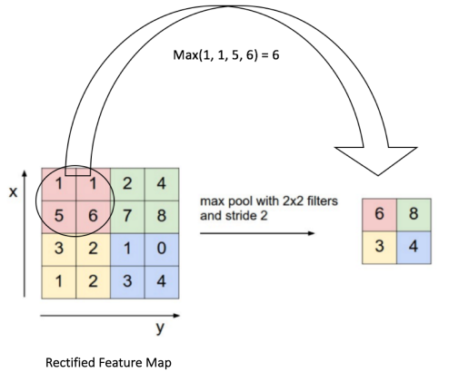

Slide 22
What is the problem?
It isn’t conducive to learning a spatial hierarchy of features. The 3 × 3 windows in the third layer will only contain information coming from 7 × 7 windows in the initial input.
The high-level patterns learned by the convnet will still be very small with regard to the initial input, which may not be enough to learn to classify digits (try recognizing a digit by only looking at it through windows that are 7 × 7 pixels!).

Slide 23
We need the features from the last convolution layer to contain information about the totality of the input.
The final feature map has 22 × 22 × 64 = 30,976 total coefficients per sample. This is huge. If you were to flatten it to stick a Dense layer of size 512 on top, that layer would have 15.8 million parameters. This is far too large for such a small model and would result in intense overfitting.

Slide 24
Why Max pooling?
The reason to use downsampling:
is to reduce the number of feature-map coefficients to process,
as well as to induce spatial-filter hierarchies by making successive convolution layers look at increasingly large windows

Slide 25
Training a convnet from scratch on a small dataset
Having to train an image-classification model using very little data is a common situation, which you’ll likely encounter in practice if you ever do computer vision in a professional context.
We’ll focus on classifying images as dogs or cats, in a dataset containing 4,000 pictures of cats and dogs (2,000 cats, 2,000 dogs).

Slide 26
You’ll start by naively training a small convnet on the 2,000 training samples, without any regularization, to set a baseline for what can be achieved
Then we’ll introduce data augmentation, a powerful technique for mitigating overfitting in computer vision.

Slide 27
We’ll review two more essential techniques for applying deep learning to small datasets:
feature extraction with a pretrained network (which will get you to an accuracy of 90% to 96%)
and fine-tuning a pretrained network (this will get you to a final accuracy of 97%)
Download the dataset from www.kaggle .com/c/dogs-vs-cats/data

Slide 28
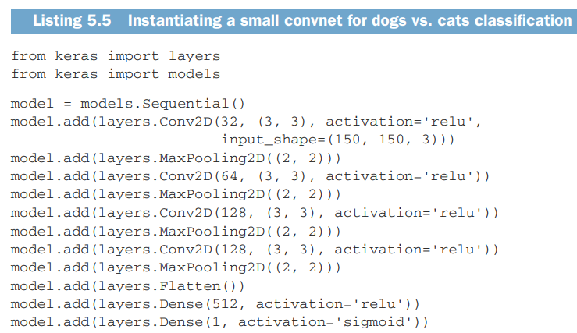

Slide 29
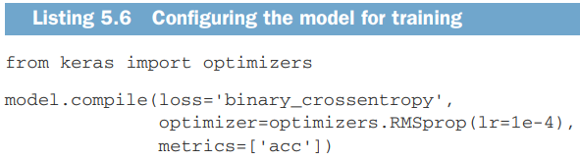

Slide 30
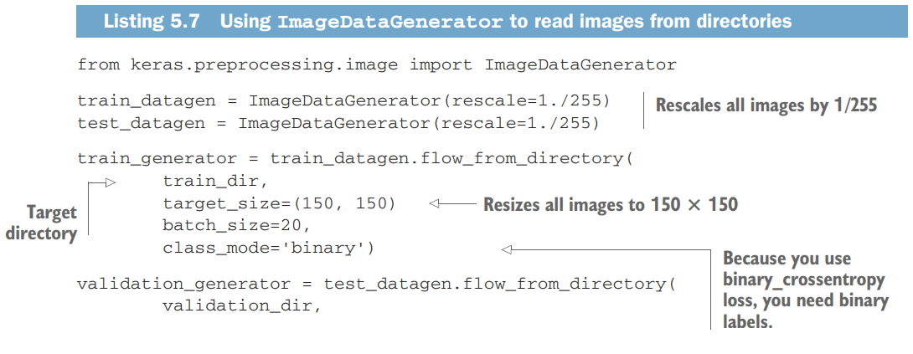

Image Data Generator

Slide 31
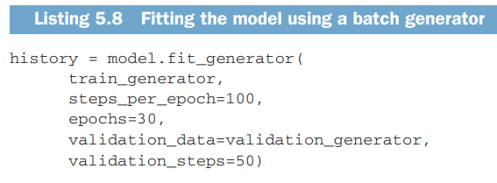

Slide 32
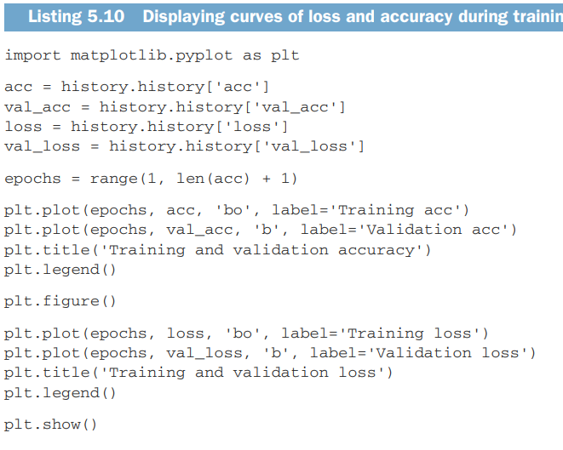

Slide 33
Data Augmentation
Overfitting is caused by having too few samples to learn from, rendering you unable to train a model that can generalize to new data
Data augmentation takes the approach of generating more training data from existing training samples, by augmenting the samples via a number of random transformations that yield believable-looking images

Slide 34
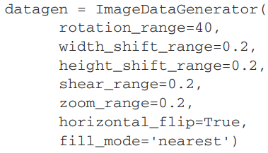
Data Augmentation

Slide 35
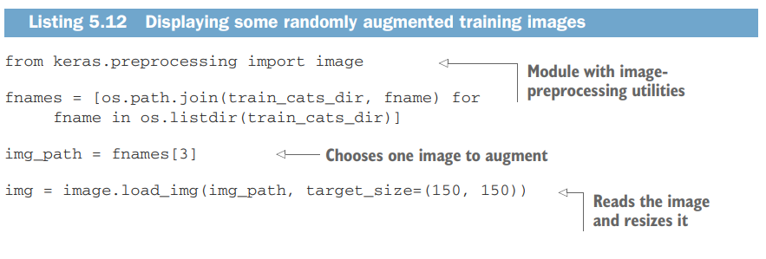
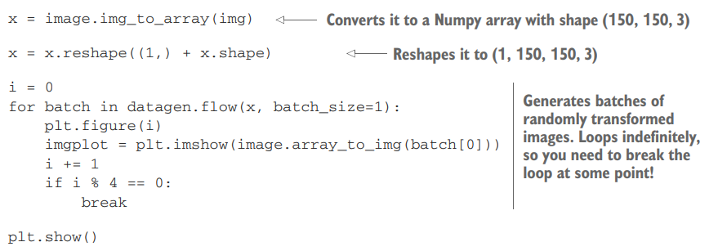

Slide 36
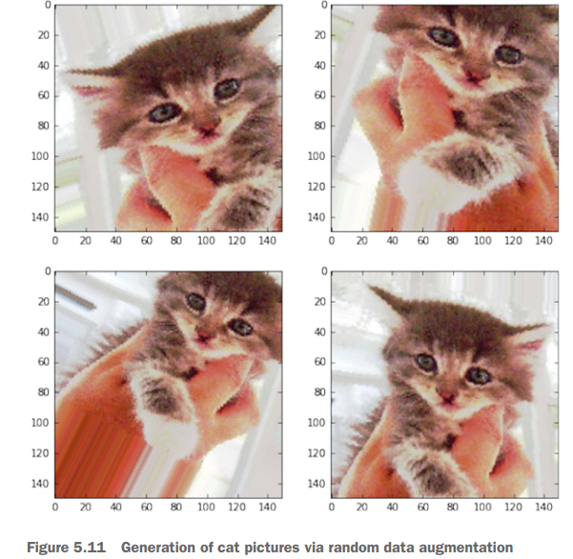

Slide 37
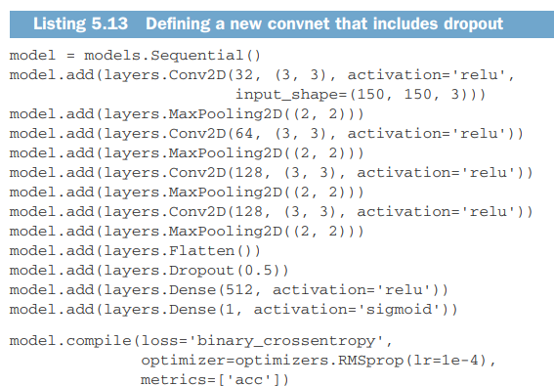
Adding a dropout layer to fight overfitting

Slide 38
Using a pre-trained ConvNet
A pretrained network is a saved network that was previously trained on a large dataset, typically on a large-scale image-classification task.
If this original dataset is large enough and general enough, then the spatial hierarchy of features learned by the pretrained network can effectively act as a generic model of the visual world, and hence its features can prove useful for many different computerv ision problems,
Even though these new problems may involve completely different classes than those of the original task.

Slide 39
Using a pre-trained model
There are two ways to use a pretrained network:
feature extraction
and fine-tuning

Slide 40
Feature Extraction
Feature extraction consists of using the representations learned by a previous network to extract interesting features from new samples.
These features are then run through a new classifier, which is trained from scratch

Slide 41
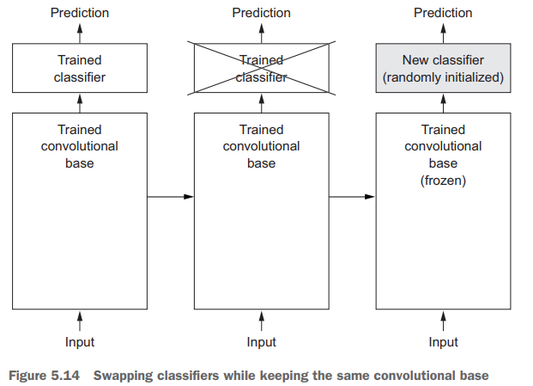
Feature Extraction
Feature extraction consists of taking the convolutional base

Slide 42
Representations learned by the convolutional base are likely to be more generic and therefore more reusable: the feature maps of a convnet are presence maps of generic concepts over a picture, which is likely to be useful regardless of the computer-vision problem at hand.
But the representations learned by the classifier will necessarily be specific to the set of classes on which the model was trained—they will only contain information about the presence probability of this or that class in the entire picture

Slide 43
Layers that come earlier in the model extract local, highly generic feature maps (such as visual edges, colors, and textures), whereas layers that are higher up extract more-abstract concepts (such as “cat ear” or “dog eye”)

Slide 44
The VGG16 model, among others, comes prepackaged with Keras.
You can import it from the keras.applications module.
Here’s the list of image-classification models (all pretrained on the ImageNet dataset) that are available as part of keras .applications:
Xception
Inception V3
ResNet50
VGG16
VGG19
MobileNet

Slide 45
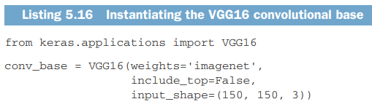

Slide 46
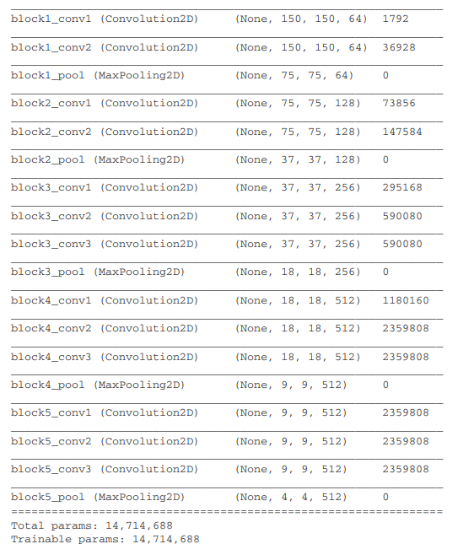

Slide 47
Feature Extraction without Data Augmentation

Slide 48
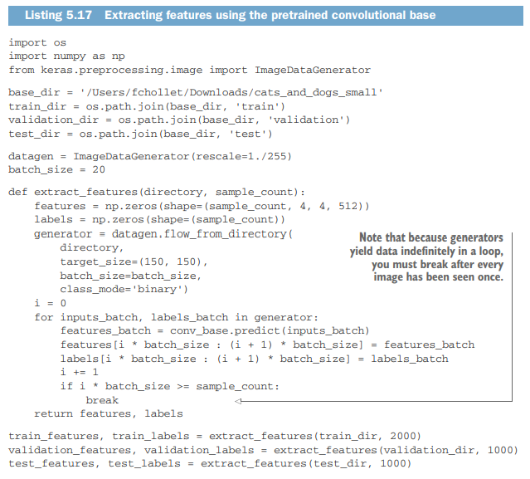

Slide 49

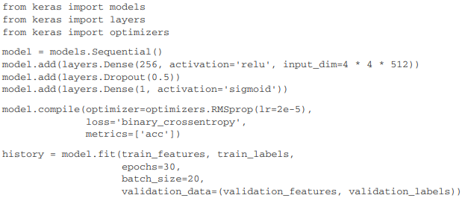

Slide 50
Feature Extraction with Data Augmentation

Slide 51
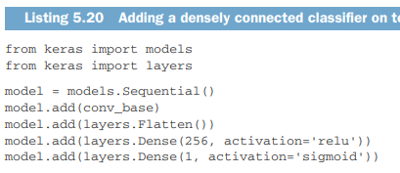

Slide 52
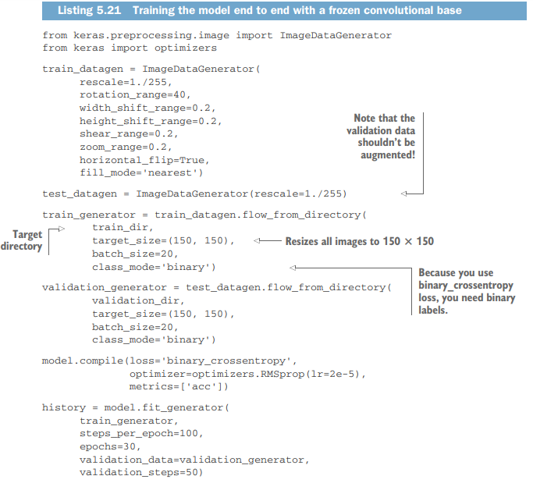

Slide 53
Fine Tuning
Another widely used technique for model reuse, complementary to feature extraction, is fine-tuning
Fine-tuning consists of unfreezing a few of the top layers of a frozen model base used for feature extraction, and jointly training both the newly added part of the model and these top layers.

Slide 54
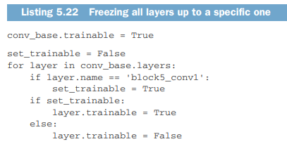

Slide 55
